Slide 1
Analysis of Propane Gas Fire Experiments and Simulations in Residential Scale Structures
Joseph M. Willi
Master of Science Thesis Defense
May 5, 2017

Slide 2
Overview
Introduction
Experimental Setup
Experimental Procedures
FDS Simulation Description
Results and Discussion
Summary

Slide 3
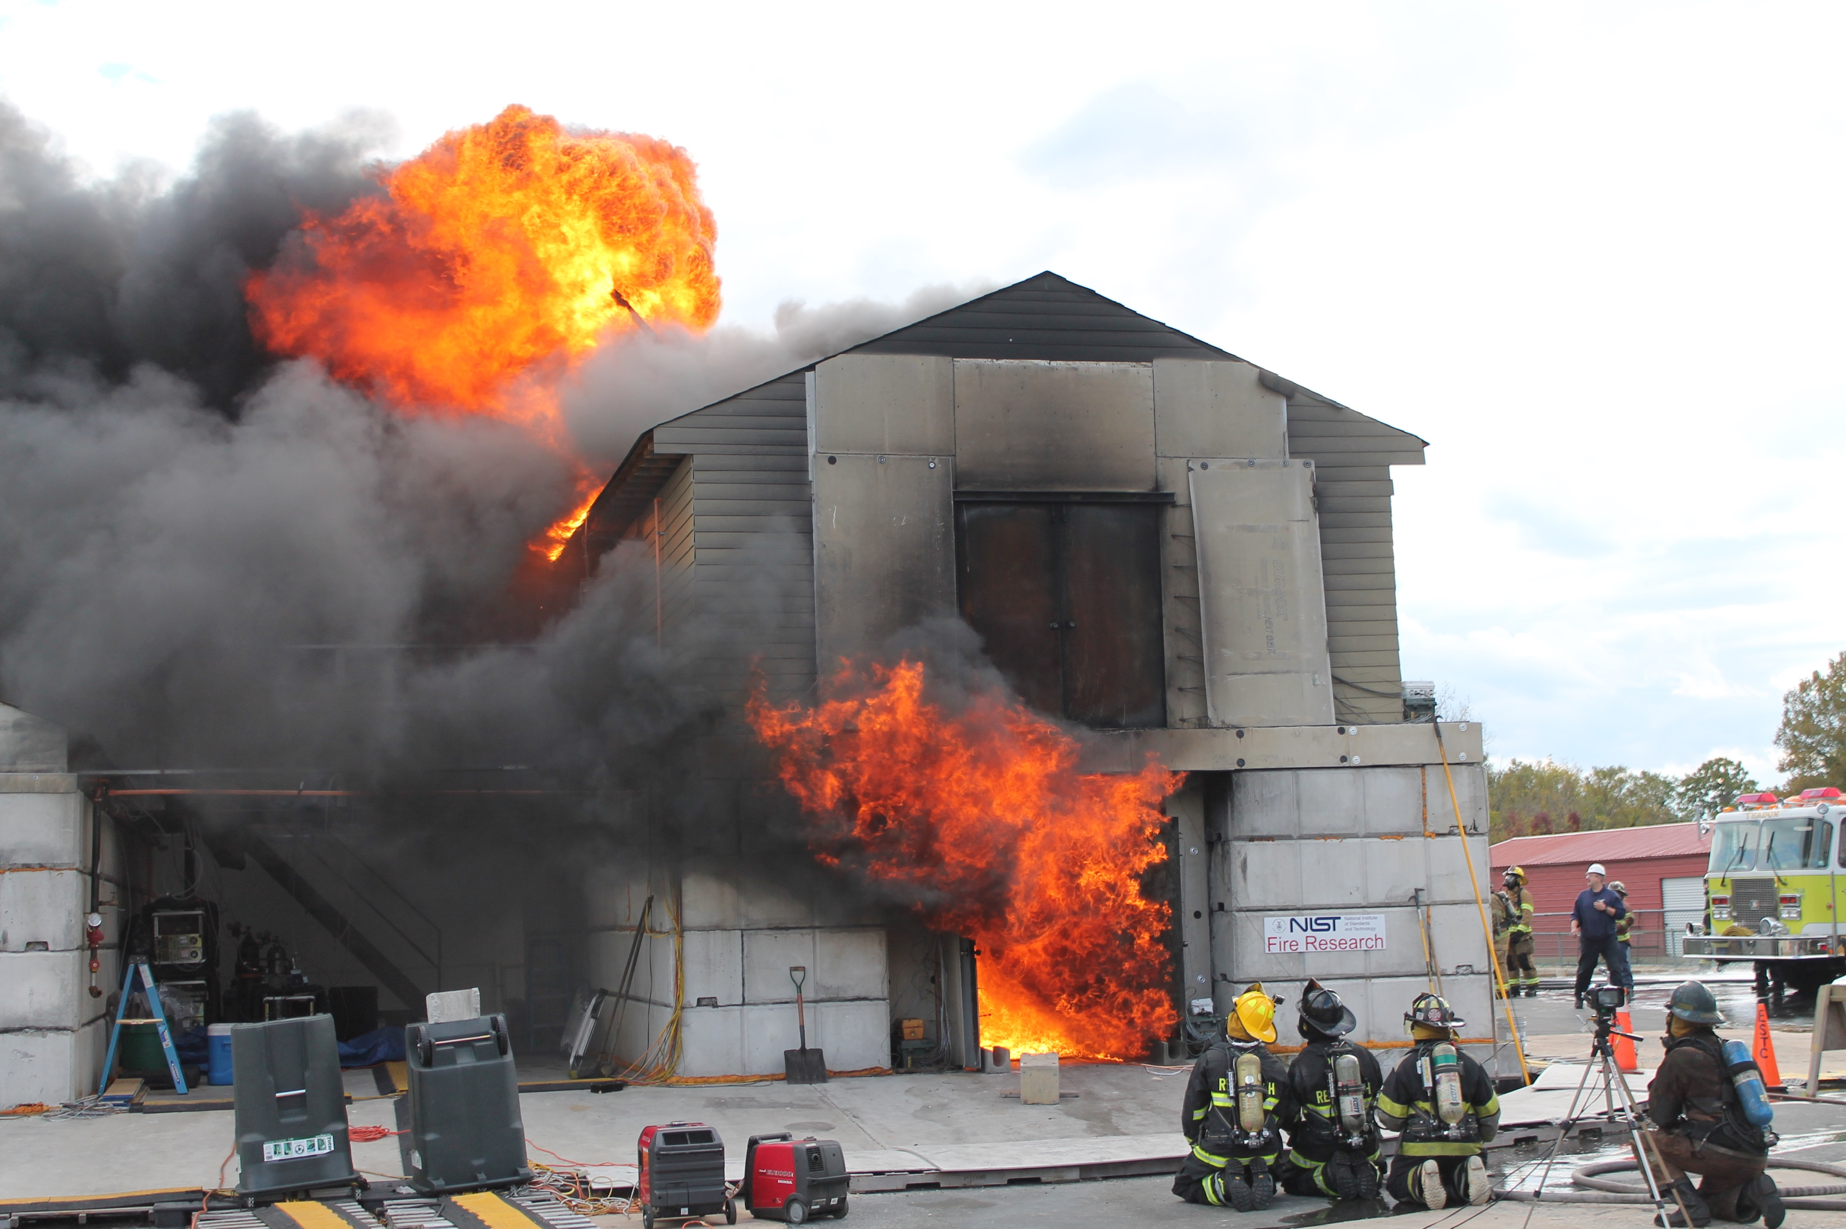
Introduction
Nine experiments in two structures
Propane gas burners used as fire source
Doors and other vents opened and closed to change ventilation
FDS (version 6.5.3) simulations of each experiment
Notes:
-- Nine experiments part of larger set of experiments, everything from cold flow tests with ppv fans to nine burner tests, to tests with much larger fuel loads, as pictured here
-- Three gas burners with propane as the fuel used for each fire; controlled by high-precision turn valves, total displaced gas volume measured by rotary gas meter
-- Different doors and vents opened during tests to change ventilation within the compartment
-- While gas temperature, velocity, carbon dioxide/O2 concentrations, and heat flux were measured at different points throughout

Slide 4
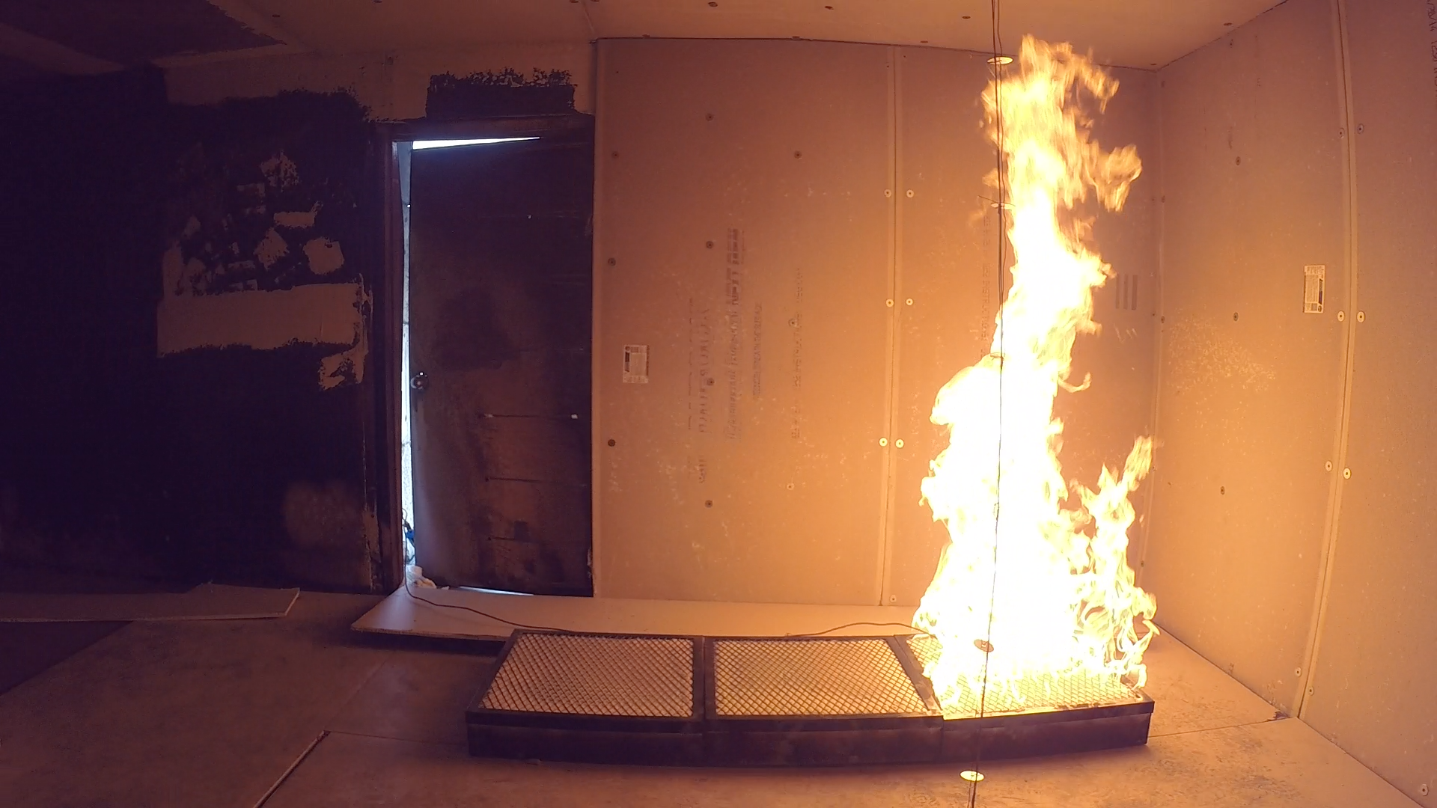
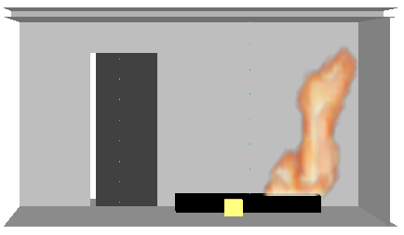
Fire Dynamics Simulator
CFD model of fire-driven fluid flow emphasis on smoke and heat transport from fires
Developed and maintained by NIST
Evaluation of program well documented by NIST in verification and validation guides [1,2]
Notes:
-- CFD model fire-drive flow; solves a form of navier stokes equations for low-speed (Ma < 0.3), thermally driven flows with emphasis on smoke & heat transport from fires
-- Most popular program used by FPEs to predict fire dynamics and smoke movement for potential fire scenarios
-- Evaluation crucial to determine limitations and acceptable uses of FDS

Slide 5
Verification vs. Validation
Verification checks the math
Validation checks the physics
Compare model results to experimental measurements
52 experiments documented in FDS Validation Guide
Nine burner tests will provide crucial addition to validation database
Notes:
-- Verification: numerical model being solved correctly,
-- Validation: checks that the governing equations are appropriate for specific application being modeled
-- 52 FDS experiments, handful are in residential size structures, none in two-story

Slide 6
Experimental Setup
Notes:
-- Pictures of structures?

Slide 7
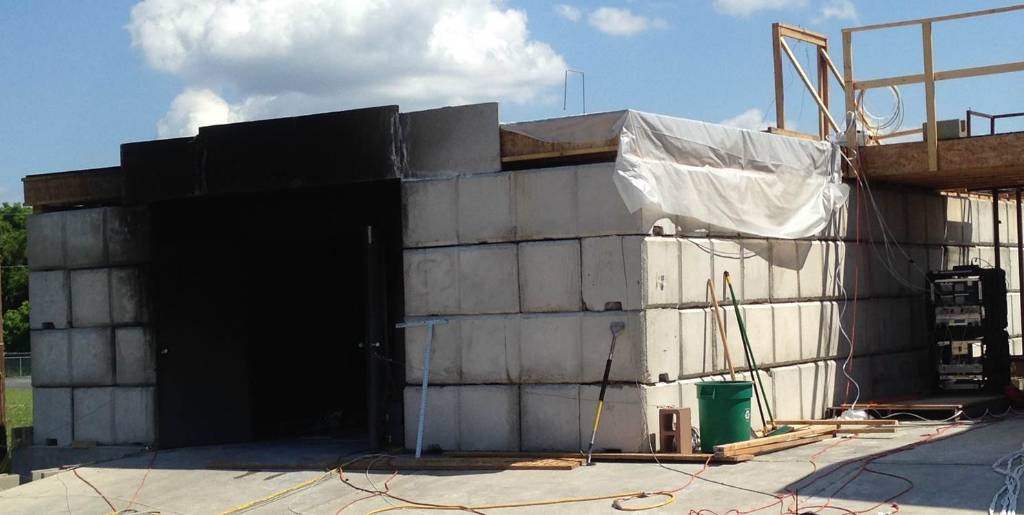
East Structure
Notes:
Highlight 2x2x4 blocks, single story, picture is of the north side

Slide 8
East Structure
Notes:
Entire structure - 24’x40’
Front and back rooms – 20’x12’, middle room 12’x10’
highlight doorways, sealed off room, ceiling height

Slide 9
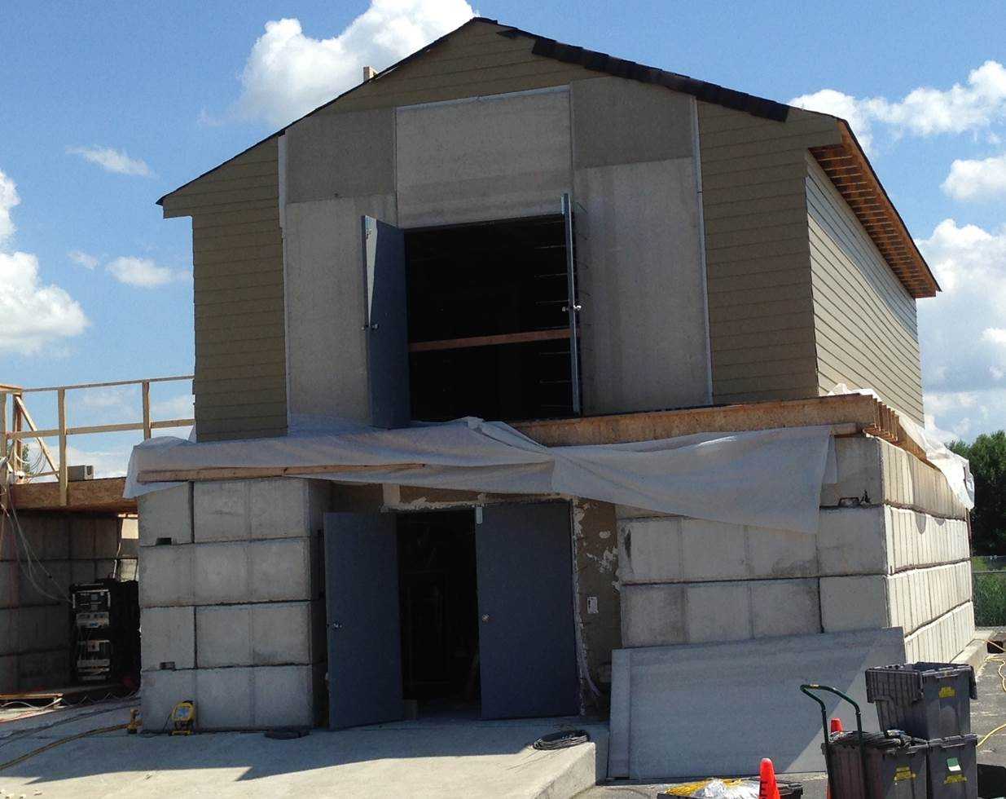
West Structure
Notes:
-- North side of structure; big differentiating factor between this and east structure is second story
-- notice ground floor similar to single-story structure 2x2x4 blocks, double doors on north side
--

Slide 10
West Structure – 1st Floor
Notes:
English units, designed like basement with walk out doors, stairs
7.25” rise/7.5” run
39’ x 23’ => interior space ~ 35’x 16’

Slide 11
West Structure – 2nd Floor
Notes:
0.8 m => 32” door
0.9 m => 36” door
Walls wood framed with 2x4s set to 16 in centers, two layers of 5/8” Type X gypsum board with a layer of ½” Durock cement board on top
Outer walls on 2nd floor had 7/16” OSB and 5/16” fiber cement lap siding

Slide 12
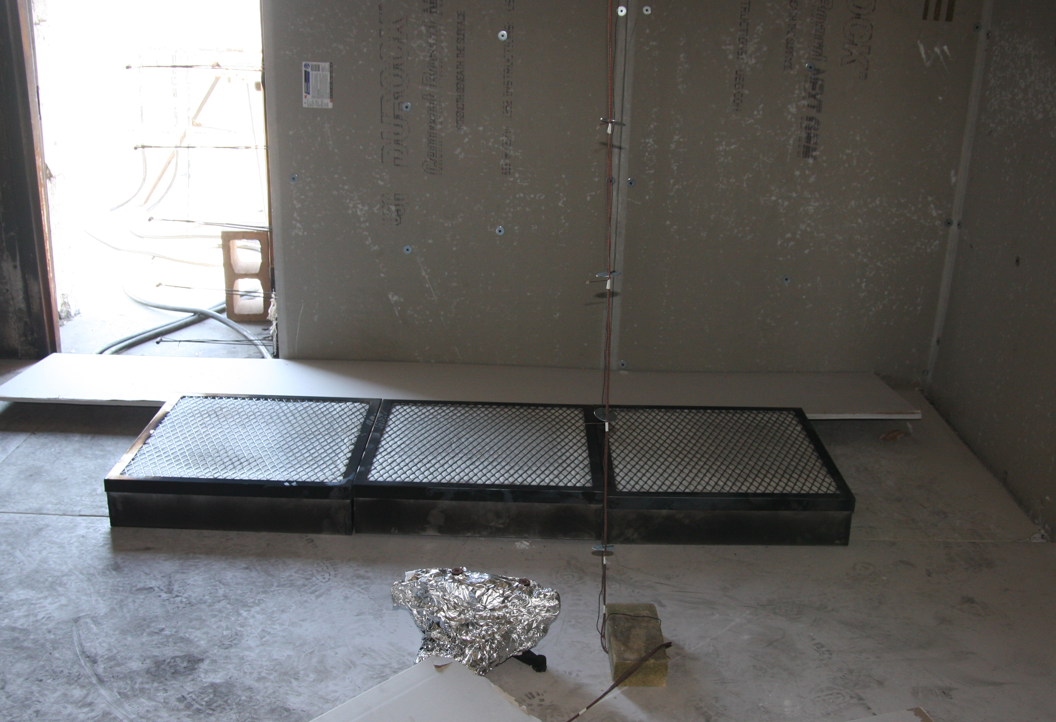
Fire Source
Three propane gas burners
Notes:
2’ x 2’ about 6” above the ground

Slide 13
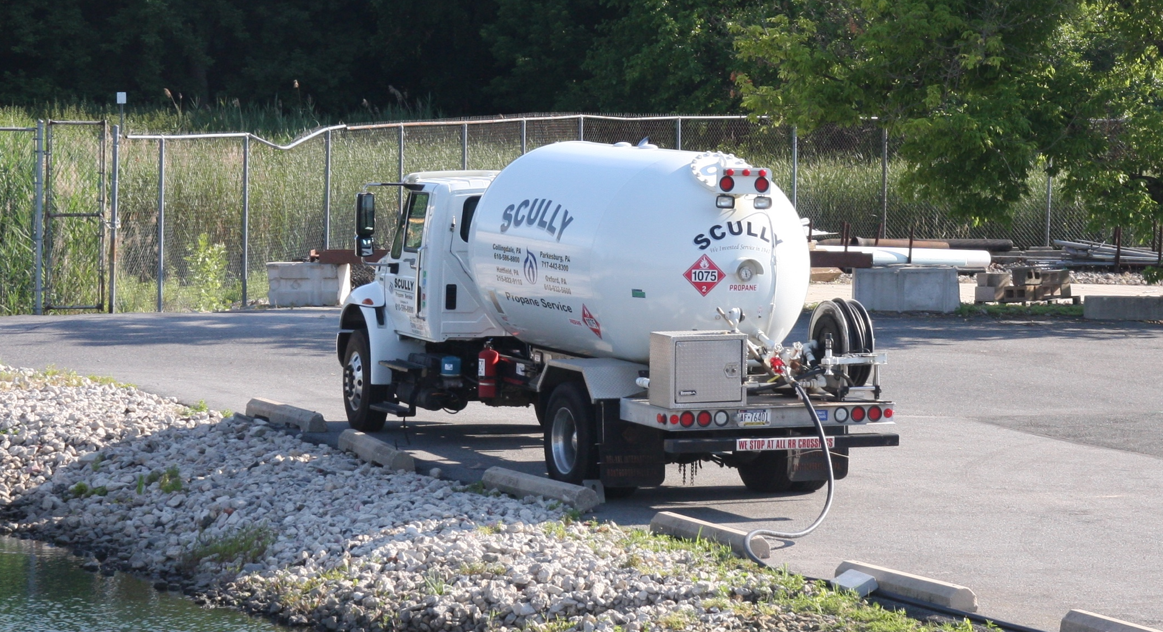
Fire Source
Provided by propane supply truck
Notes:
Propane supply for commercial industrial applications

Slide 14
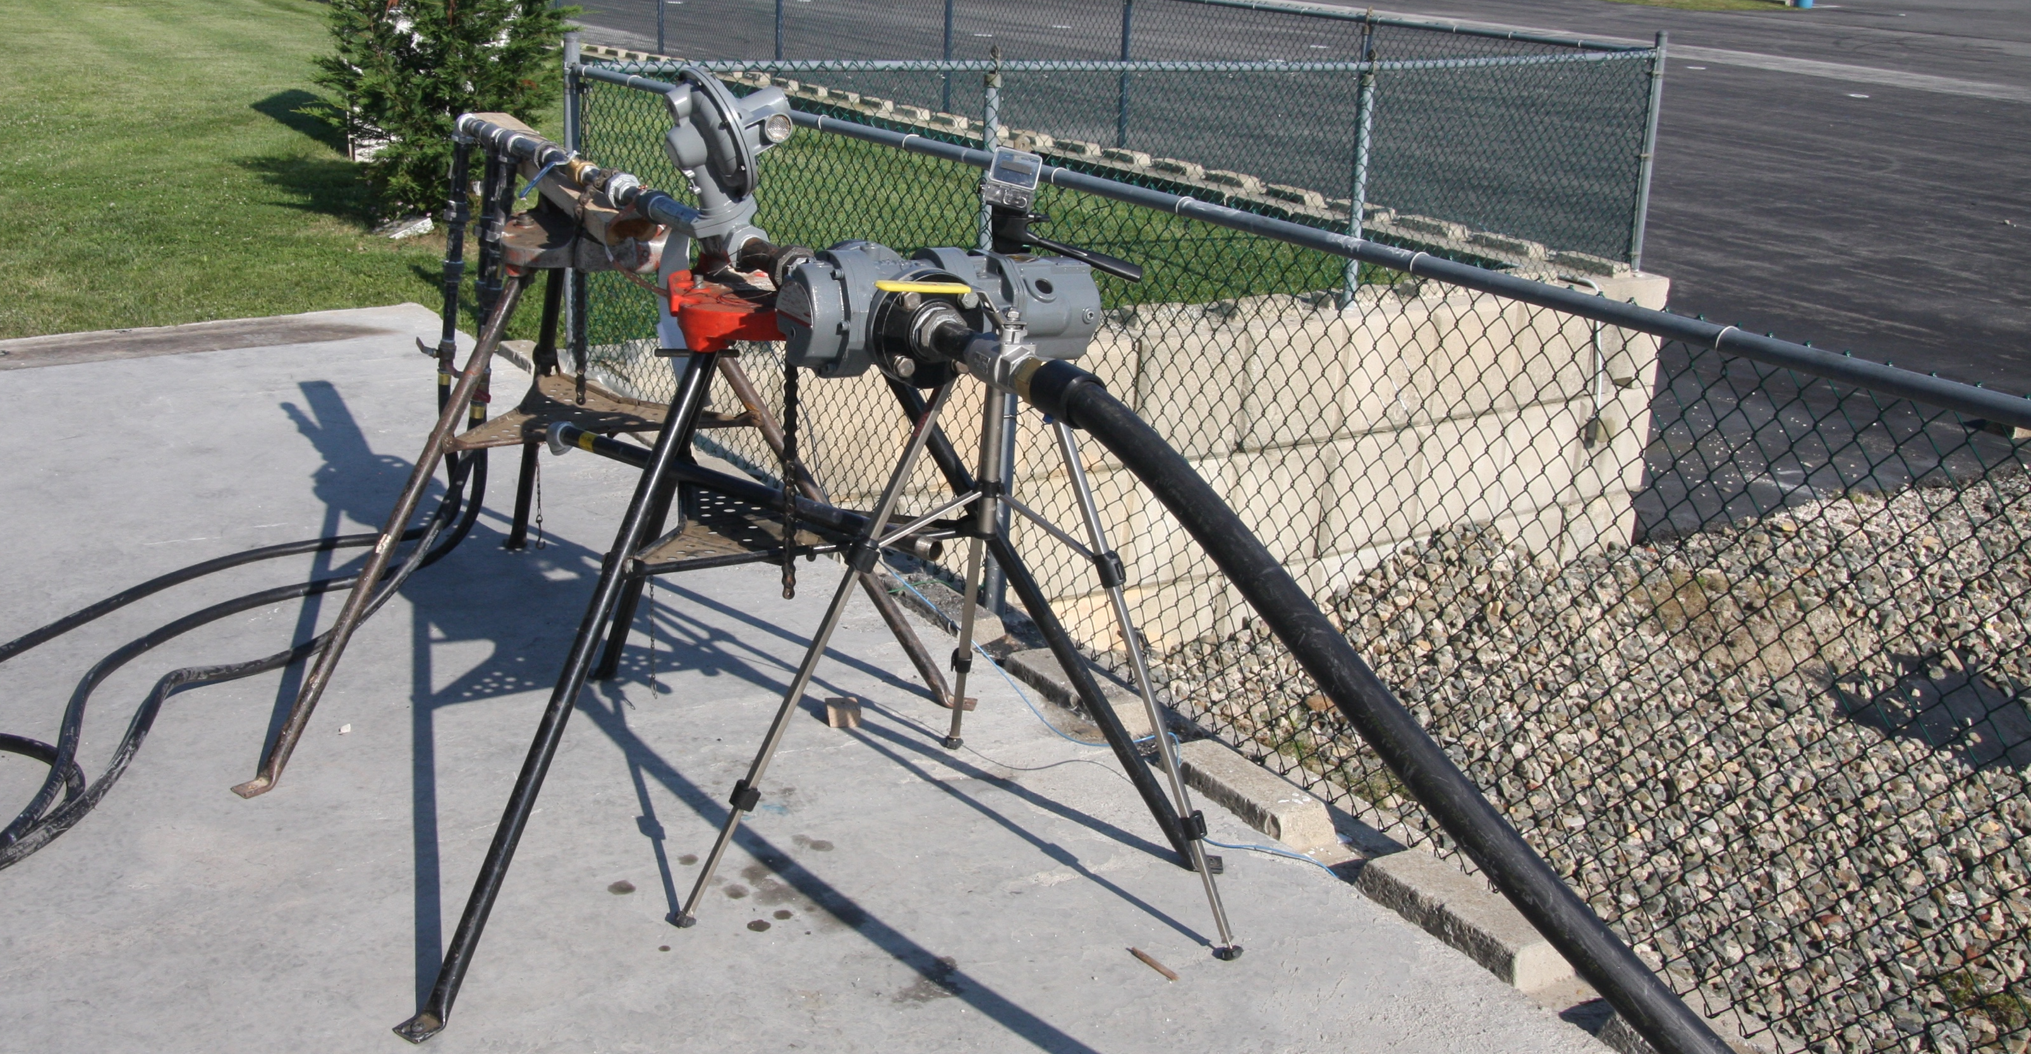
Fire Source
Controlled and measured at rotary gas meter
8% uncertainty associated with HRR measurement [1]
Notes:
Zoom into each part of apparatus

Slide 15
Instrumentation
Thermocouples
Gas species concentrations
Bi-directional probes
Heat flux gauges
Notes:
Floor plans with each type of instrumentation highlighted, uncertainty described

Slide 16
Thermocouples
Bare-bead, type K from OMEGA Engineering Inc.
Eight thermocouples per array, spaced 1 ft apart with top 1 in below ceiling
Total expanded uncertainty 15 % [2,3]

Slide 17
Thermocouple Arrays
East Structure

Slide 18
Thermocouple Arrays
West Structure – 1st Floor

Slide 19
Thermocouple Arrays
West Structure – 2nd Floor

Slide 20
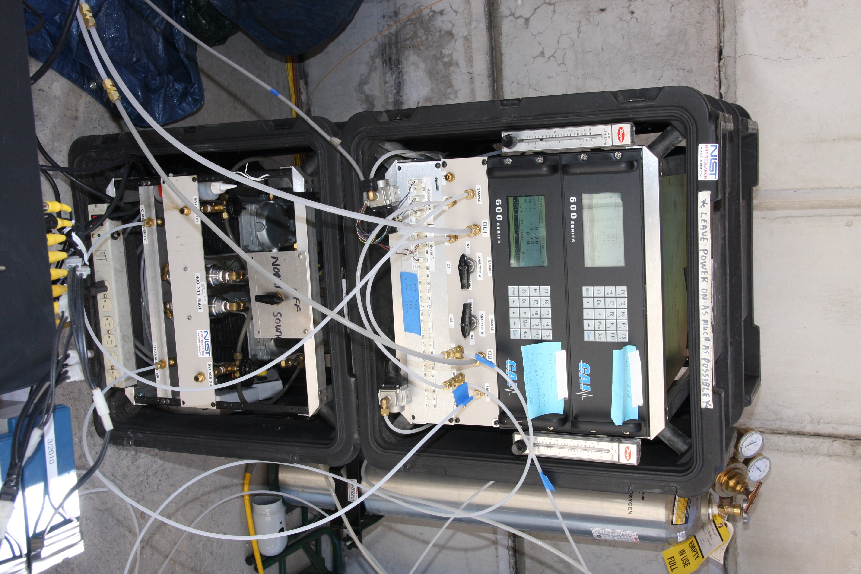
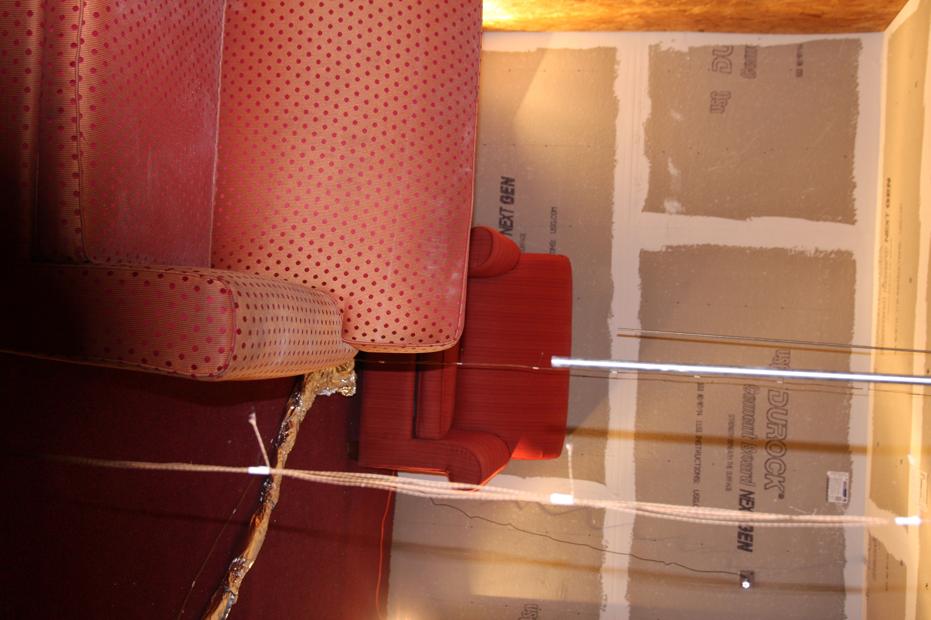
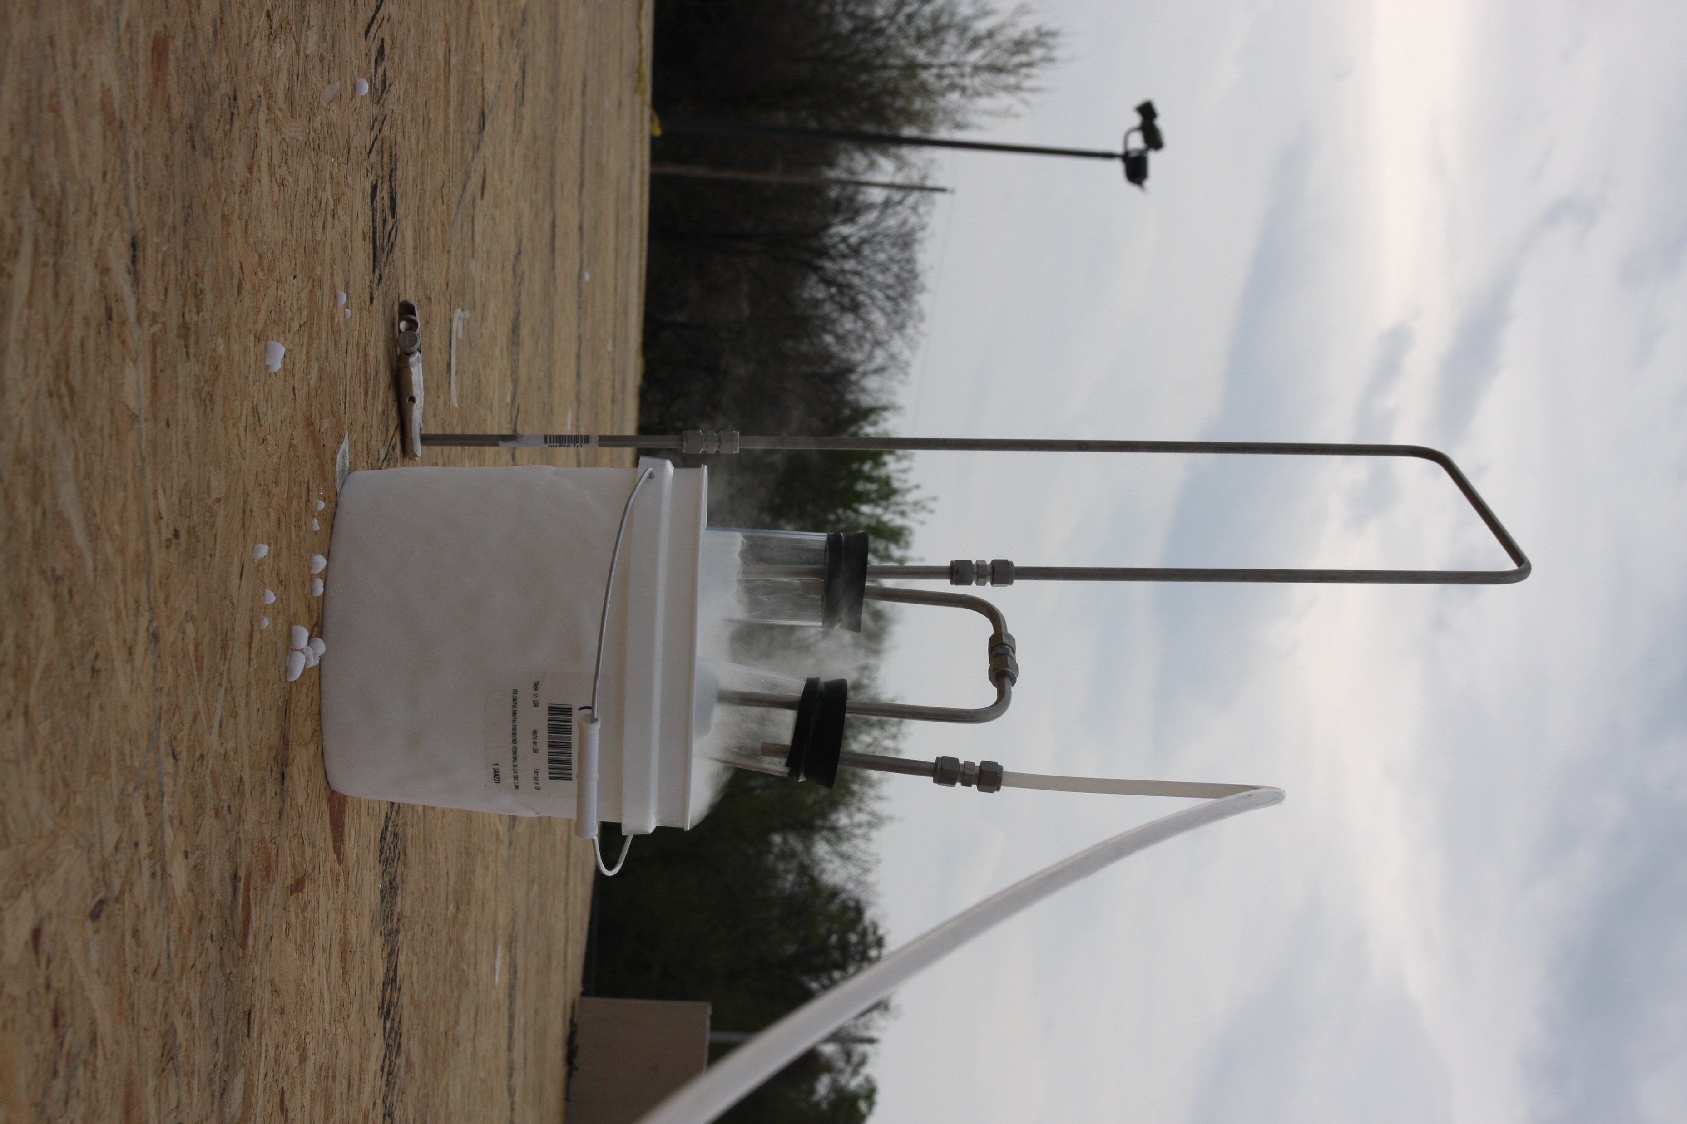
Gas Sampling
System from California Analytical Instruments, Inc.
Pulled through 3/8” stainless steel tubing located 4 ft above floor through filter to cool sample
Total expanded uncertainty – 12 % [3]

Slide 21
Gas Sampling
East Structure

Slide 22
Gas Sampling
West Structure – 1st Floor

Slide 23
Gas Sampling
West Structure – 2nd Floor

Slide 24
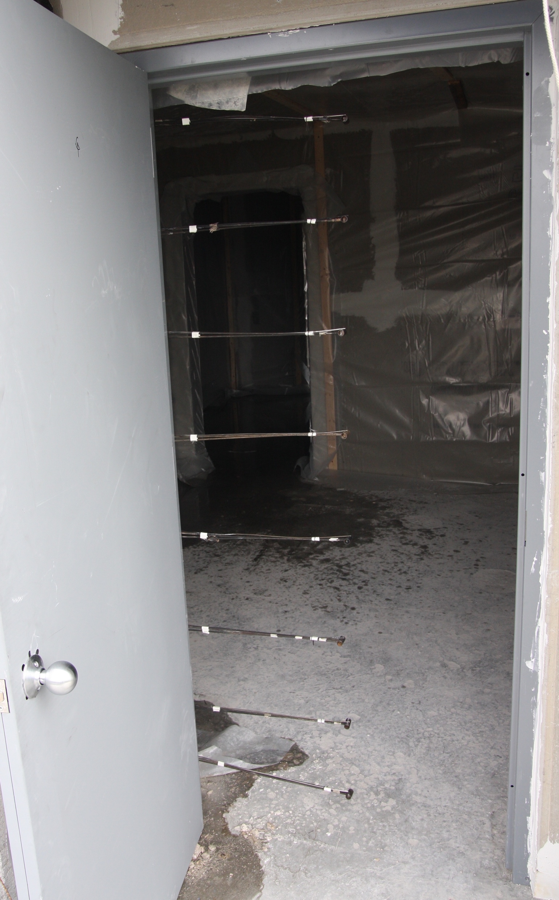
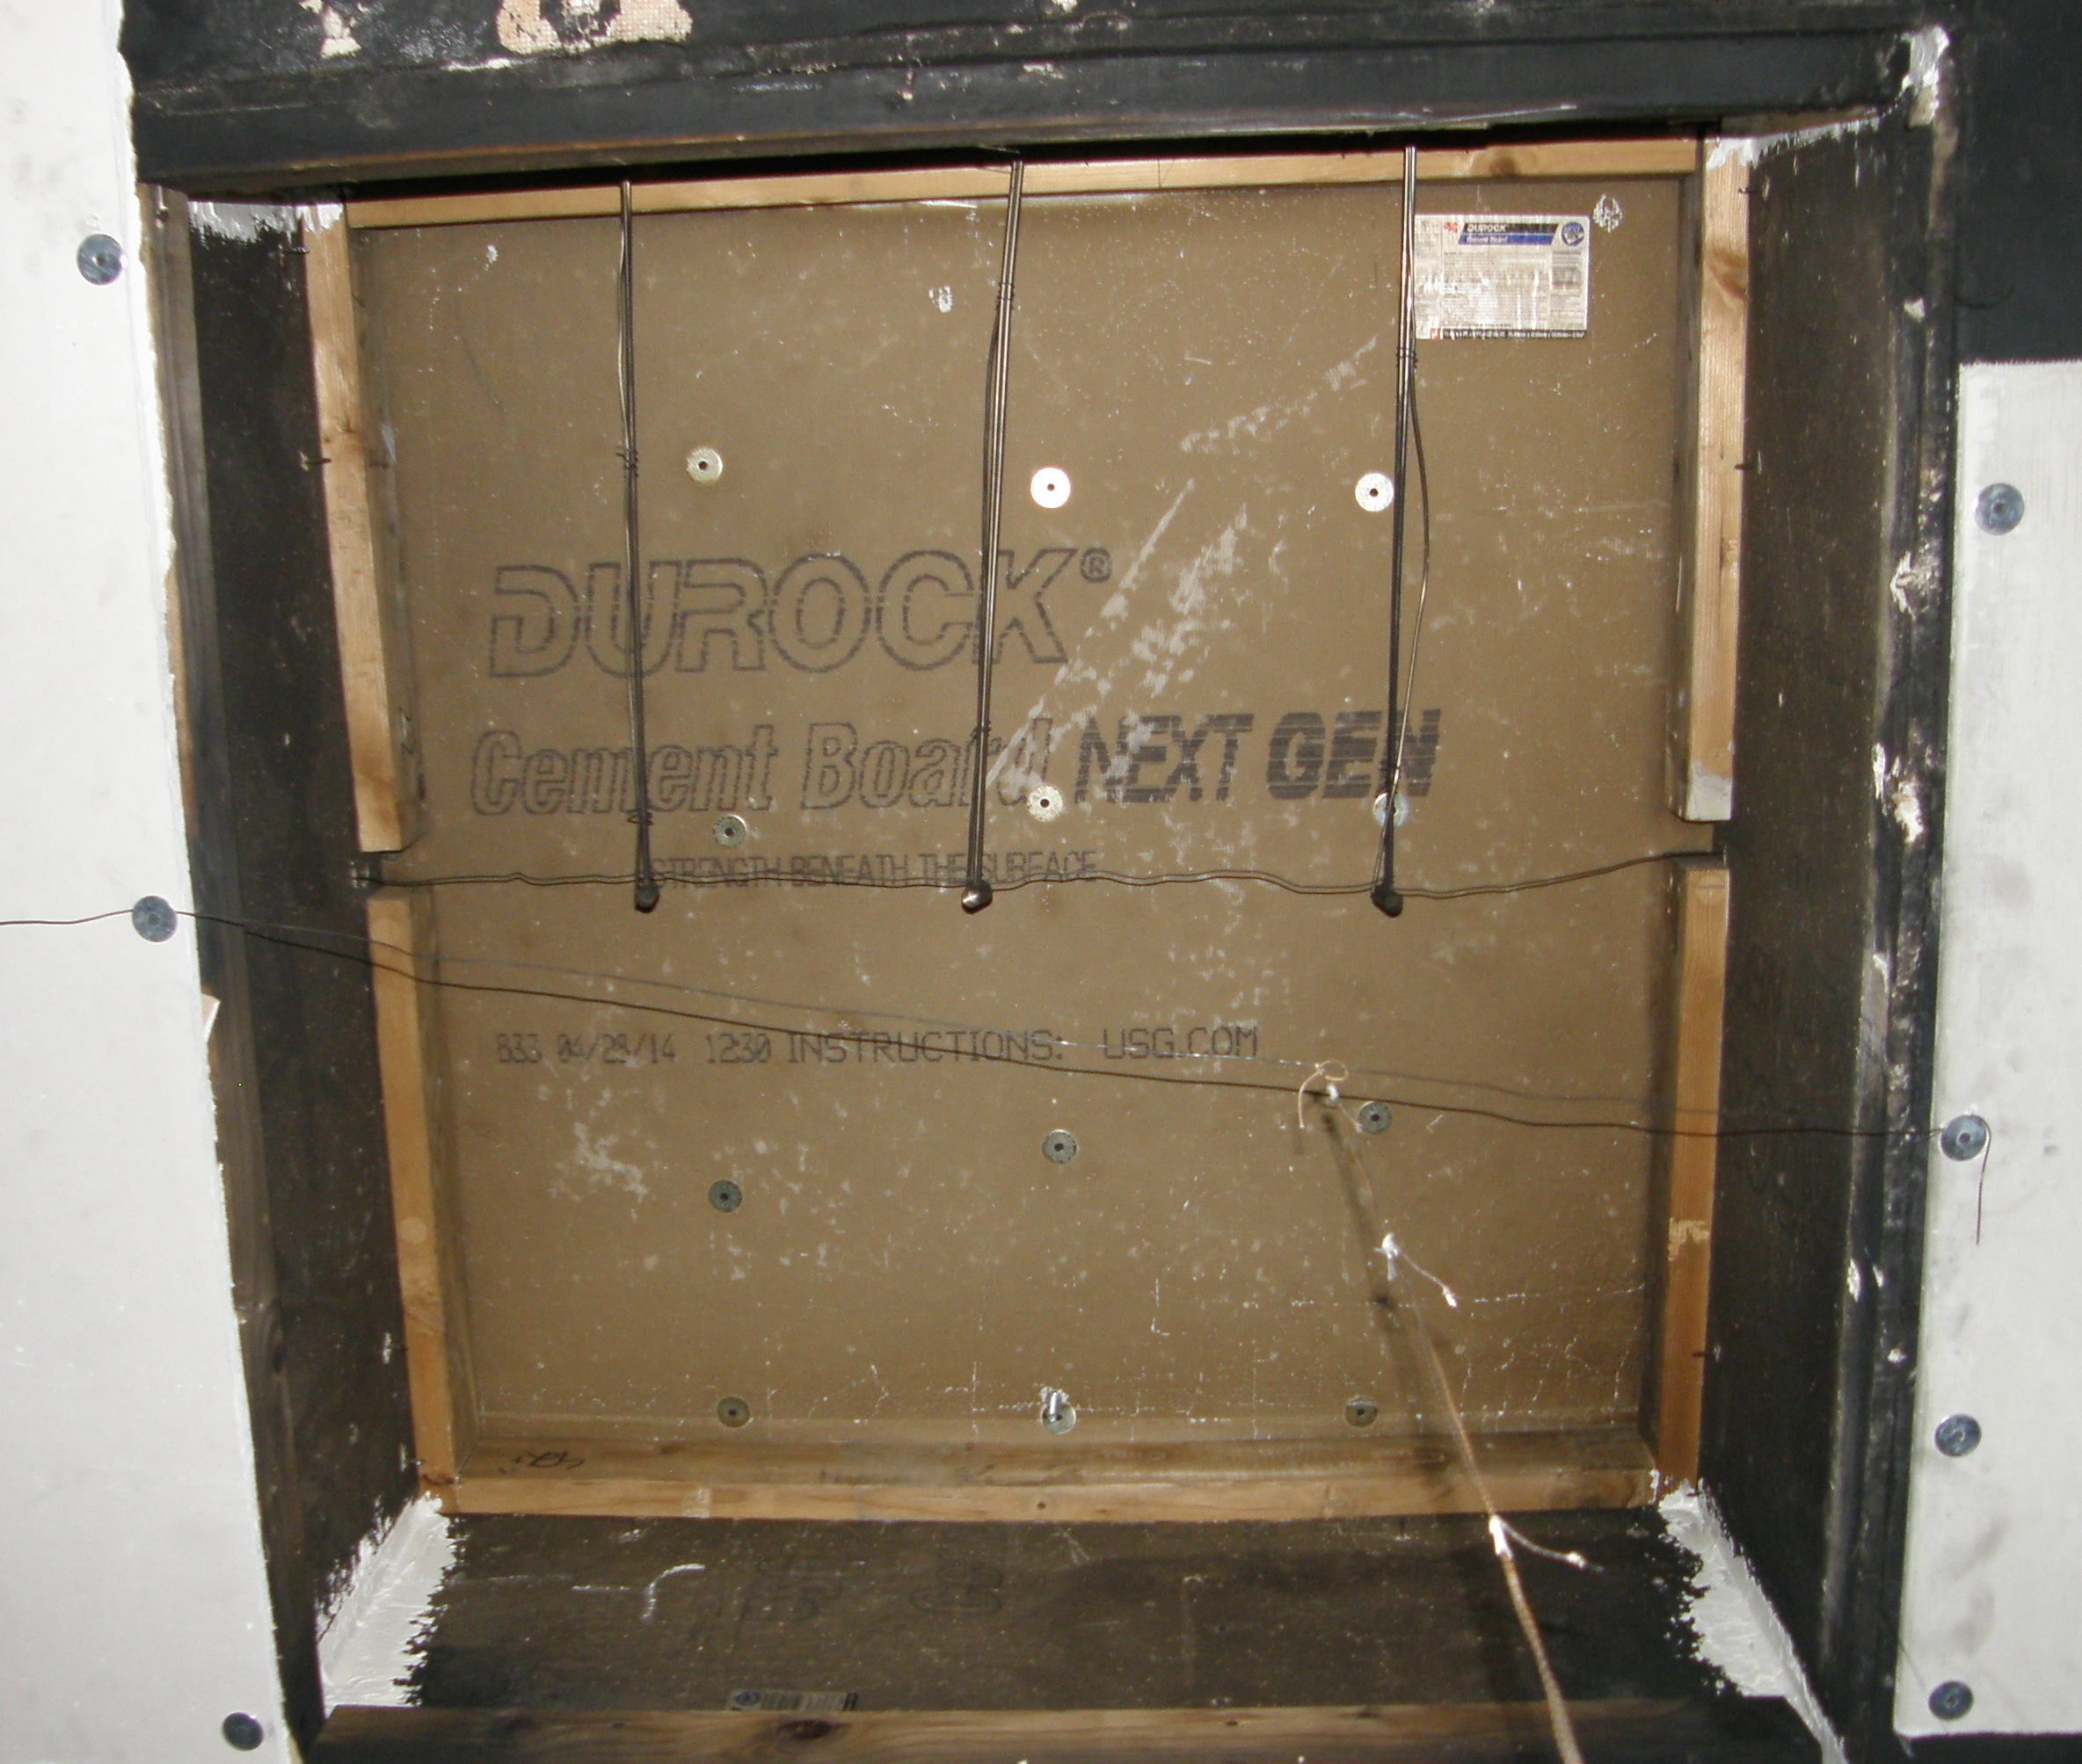
Bi-Directional Probes
BDPs with pressure transducers from Setra Systems
East Structure: three probes centered in roof vent
West Structure: eight probes centered in doorway
14 % to 22 % uncertainty [4] (18 % used for analysis)
Notes:
Each probe in doorway centered and spaced 10” apart with top one 3” below soffit

Slide 25
BDP Array
East Structure

Slide 26
BDP Array
West Structure – 2nd Floor

Slide 27
Total Heat Flux
Water-cooled, Schmidt-Boelter total heat flux gauges
East Structure: single gauge 6” above floor, facing ceiling
West Structure: pair of gauges 3’ 3” above floor, one facing ceiling, one facing wall
Total expanded uncertainty – 8 % [6]

Slide 28
Heat Flux Gauges
East Structure

Slide 29
Heat Flux Gauges
West Structure

Slide 30
Experimental Procedures

Slide 31
Overview of Experiments

Slide 32
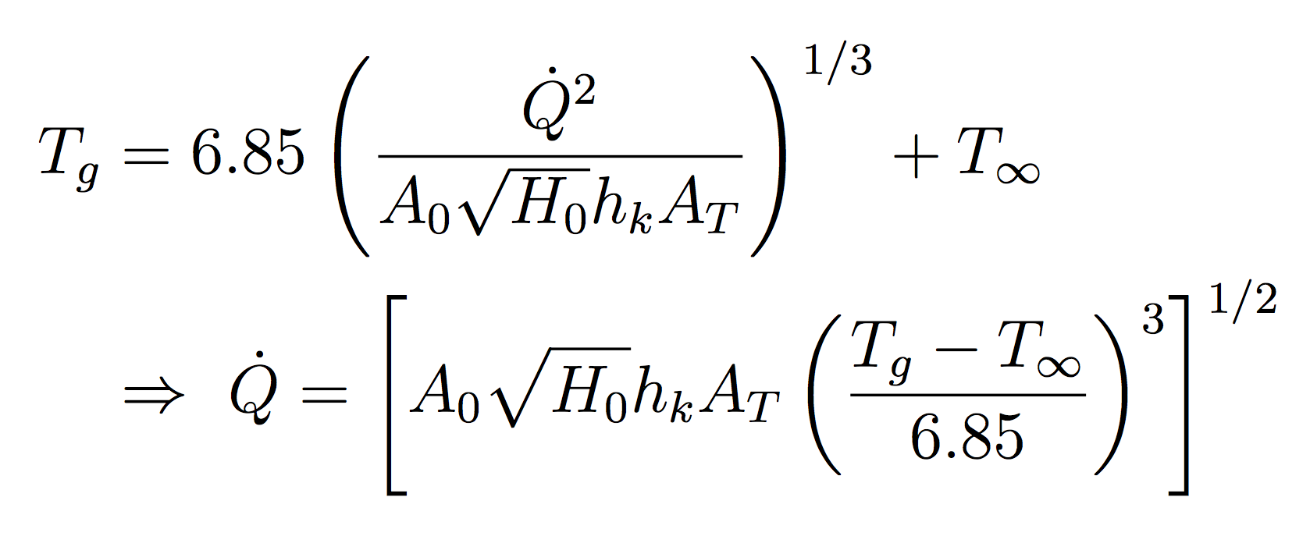
Tests 2-4 Heat Release Rate
Estimated via McCaffrey, Quintiere, and Harkleroad (MQH) correlation [7]:
HGL temperatures estimated using thermocouple data
Notes:
-- h_k is the effective heat transfer coefficient; calculated by k/thickness
-- A_T is total area of compartment enclosing surfaces

Slide 33
Tests 2-4
Notes:
~ 3 minutes between burner ignitions
About 60 seconds til first door
2 minutes until 2nd double door
60 seconds until rear door

Slide 34
Tests 2-4
Notes:
~ 2 minutes between south door and first burner off
~ 2 minutes between next burners being extinguished
~ PPV after the test to help cool down structure

Slide 35
Test 5

Slide 36
Test 5

Slide 37
Test 6

Slide 38
Tests 22 & 23

Slide 39
Tests 24 & 25

Slide 40
Tests 24 & 25

Slide 41
FDS Simulation Description
Notes:
Pictures of smokeview structures

Slide 42
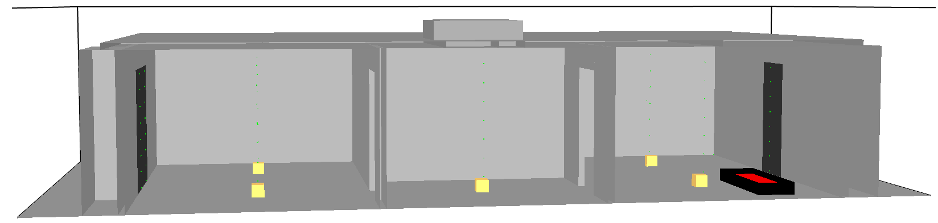
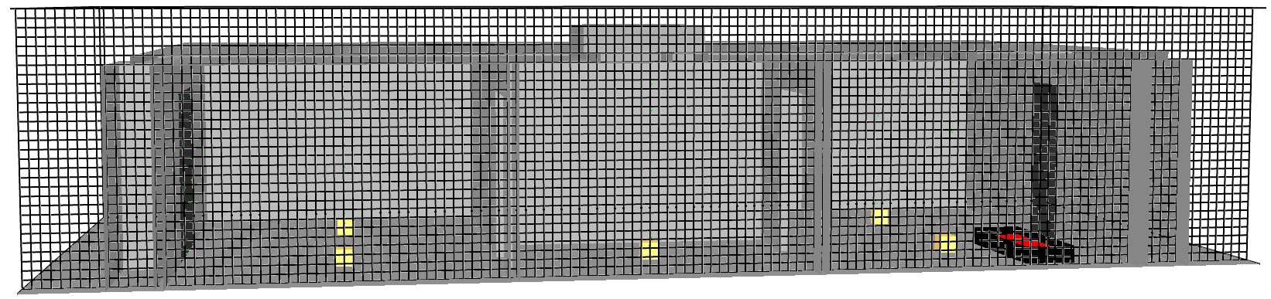
Computational Domain
Simulation domain divided into 3D rectangular computational cells
Gas density, velocity, temperature, pressure, species concentration calculated within each grid cell
Notes:
-- Using laws of mass, momentum, and energy conservation…

Slide 43
Computational Domain
Smaller cells → higher resolution
More cells → higher computational cost
How should the grid cell size be selected?
Notes:
-- Using laws of mass, momentum, and energy conservation…

Slide 44
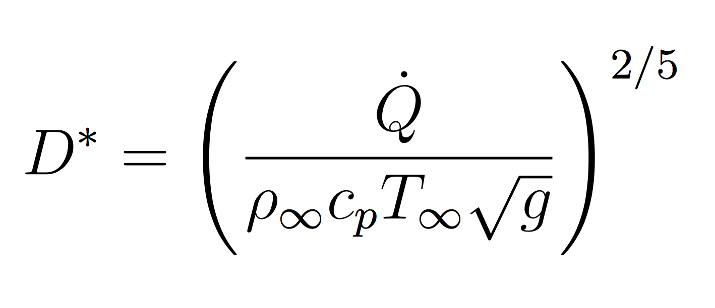
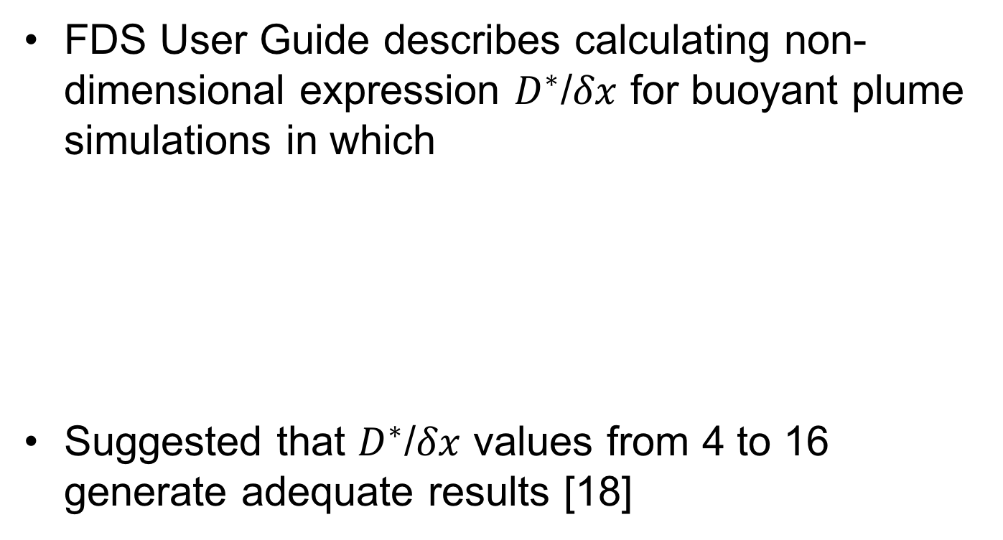
Grid Cell Size Selection
FDS User Guide describes calculating non-dimensional expression $D^{∗}$/$δx$ for buoyant plume simulations in which
Suggested that $D^{∗}$/$δx$ values from 4 to 16 generate adequate results [18]
Notes:
-- cp specific heat of surrounding air

Slide 45
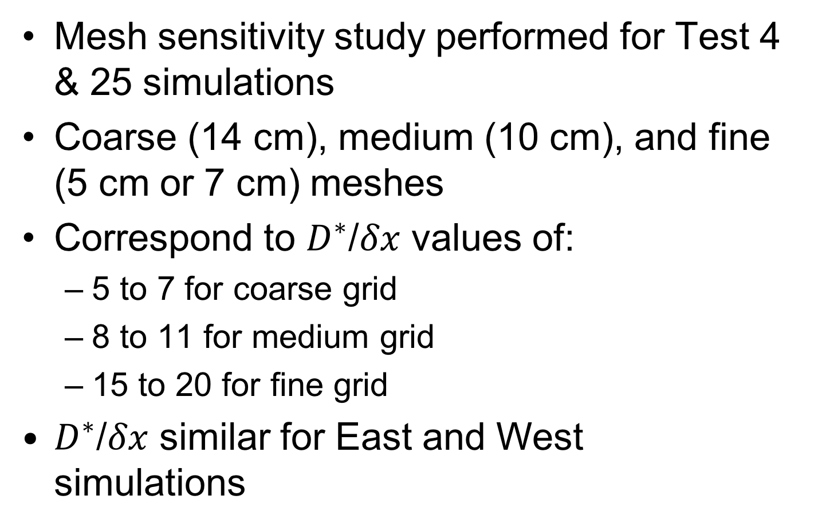
Grid Cell Size Selection
Mesh sensitivity study performed for Test 4 & 25 simulations
Coarse (14 cm), medium (10 cm), and fine (5 cm or 7 cm) meshes
Correspond to $D^{∗}$/$δx$ values of:
5 to 7 for coarse grid
8 to 11 for medium grid
15 to 20 for fine grid
$D^{∗}$/$δx$ similar for East and West simulations
Notes:
-- Equally sized meshes per simulation to utilize MPI-parallell processing on multi-processor Linux machine

Slide 46
Mesh Sensitivity Analysis
East Structure – Ceiling Jet Temperature

Slide 47
Mesh Sensitivity Analysis
East Structure – Oxygen Concentration

Slide 48
Mesh Sensitivity Analysis
West Structure – Ceiling Jet Temperature

Slide 49
Mesh Sensitivity Analysis
West Structure – Oxygen Concentration

Slide 50
Grid Cell Size Selection
Run times:
Medium grid cell size selected (10 cm)
East Structure: 336,000 computational cells
West Structure: 604,800 computational cells
Cells divided into eight equally sized meshes
Notes:
-- Smokeview pictures; grid
-- Equally sized meshes per simulation to utilize MPI-parallell processing on multi-processor Linux machine

Slide 51
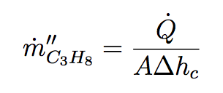
Source Fire Characterization
Steel sides, top surface specified mass flux of propane based on
Single-step reaction mechanism:
Notes:
-- Reaction mechanisms for combustion in all simulations default mixing controlled, simple chemistry model
-- Smokeview picture of burners
-- Value of Delta h_c

Slide 52
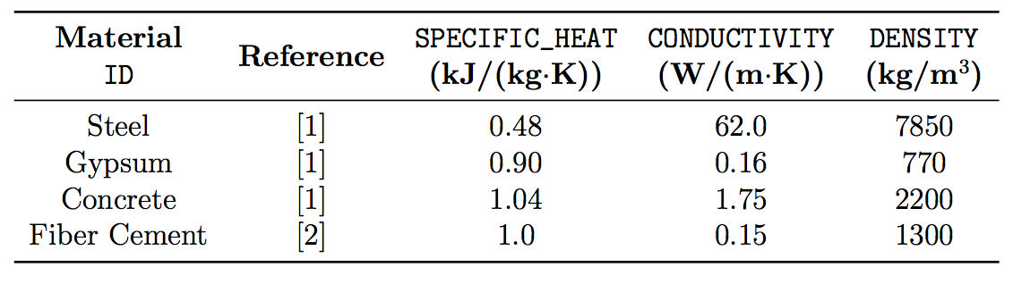
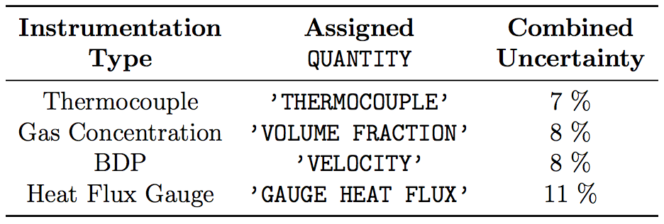
Other Defined Parameters
Four materials were defined using MATL namelist group
Instrumentation defined using FDS devices
Notes:
-- Add correct refs to table

Slide 53
Results and Discussion

Slide 54
Types of Data Plots
Two types of plots presented for each data quantity
Experimental and FDS simulation data plots
Summary log/log scatter plots similar to those presented in FDS Validation Guide [ref]
Log/log plots intended to summarize uncertainty of model in predicting specific measurement
Summary plots exclude data from Tests 2-4
Notes:
Hot gas layer T, ceiling jet T, individual TCs in TC arrays, CO2 and O2 concentrations, Gas velocity, total heat flux

Slide 55
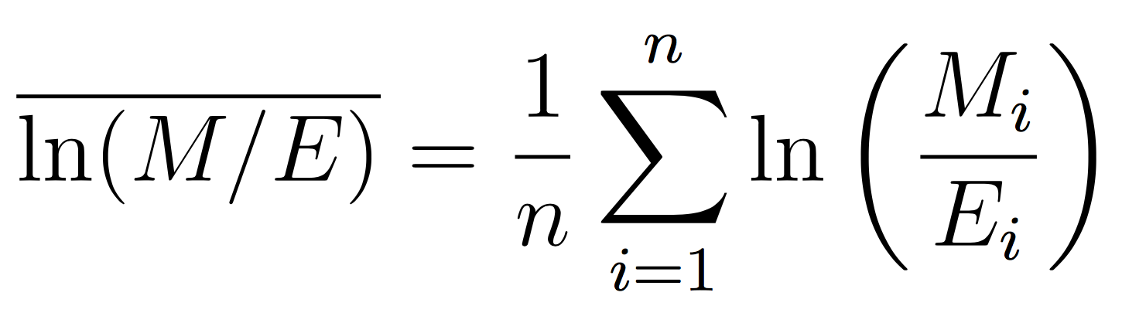
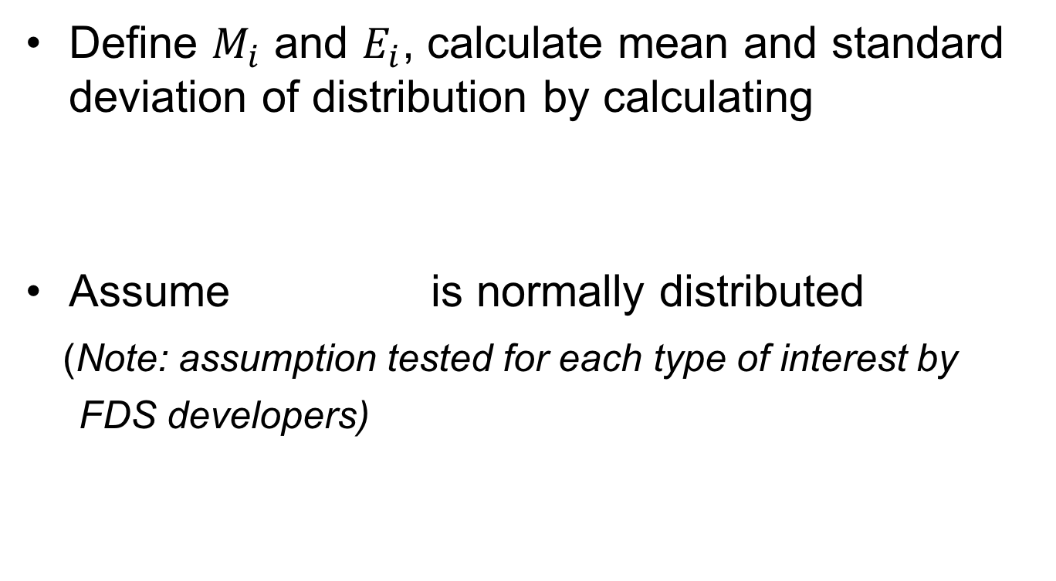
Summary Plots
Define $M_{i}$ and $E_{i}$, calculate mean and standard deviation of distribution by calculating
Assume is normally distributed
(Note: assumption tested for each type of interest by
FDS developers)
Notes:
-- assume ln(M/E) is normally distributed

Slide 56
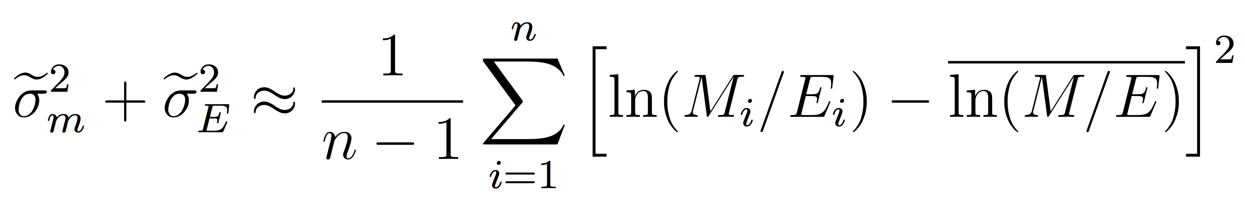
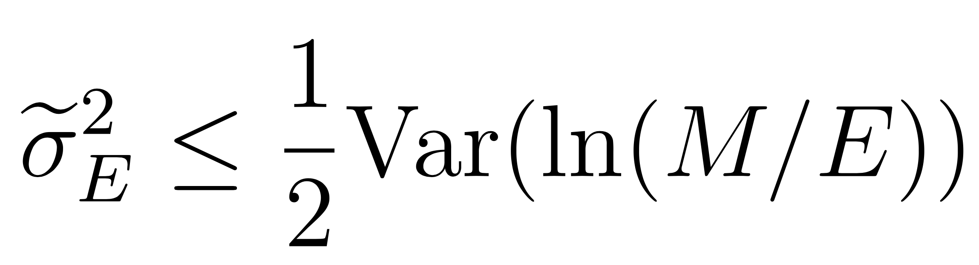
Summary Plots
Standard deviation of log of a normally distributed random variable approximately equal to standard deviation divided by its mean
Least squares estimate of standard distribution of combined distribution defined as
Impose constraint that
Notes:
-- assume ln(M/E) is normally distributed
-- know sigma e

Slide 57
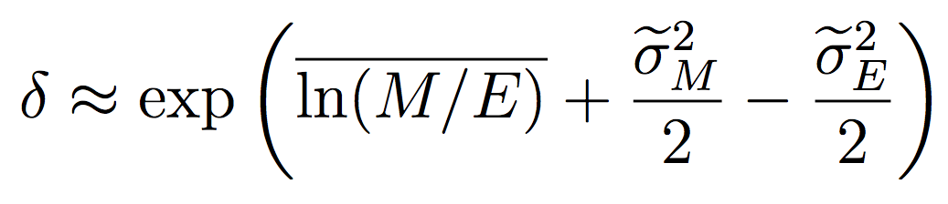


Summary Plots
The following is produced
And a bias factor can be estimated by
Notes:
-- Example from FDS Validation Guide?
-- describe gray points; solid lines expected values, dashed lines +/-, etc.

Slide 58
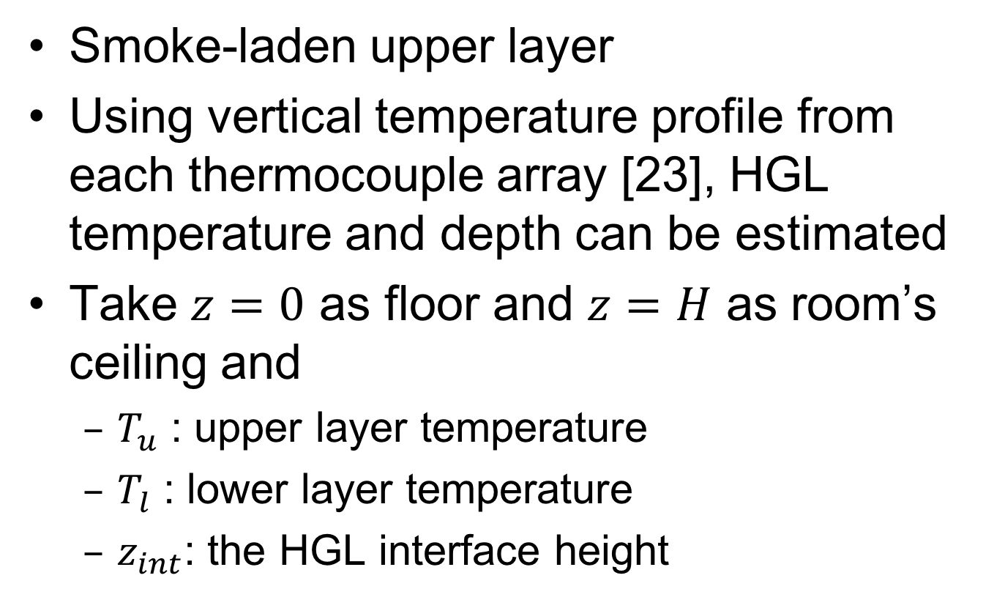
HGL Temperature Estimation
Smoke-laden upper layer
Using vertical temperature profile from each thermocouple array [23], HGL temperature and depth can be estimated
Take $z=0$ as floor and $z=H$ as room’s ceiling and
$T_{u}$ : upper layer temperature
$T_{l}$ : lower layer temperature
$z_{int}$: the HGL interface height
Notes:
-- Picture of HGL

Slide 59
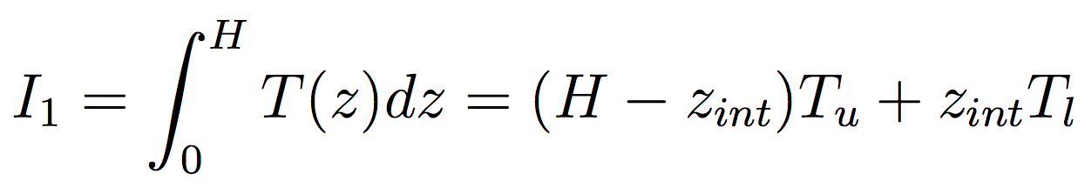
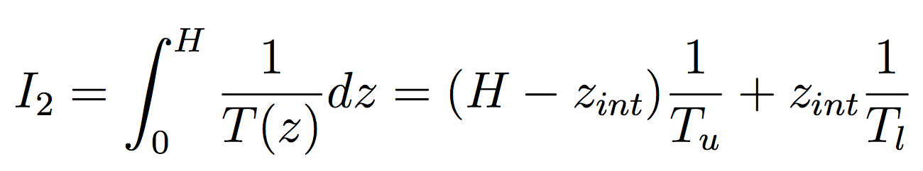
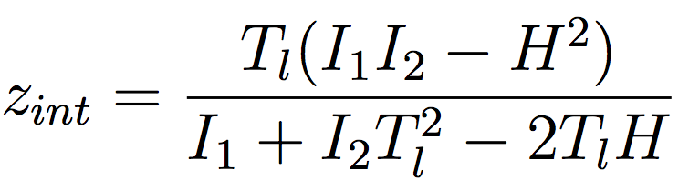
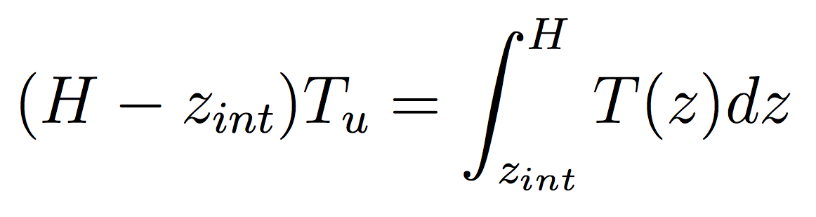
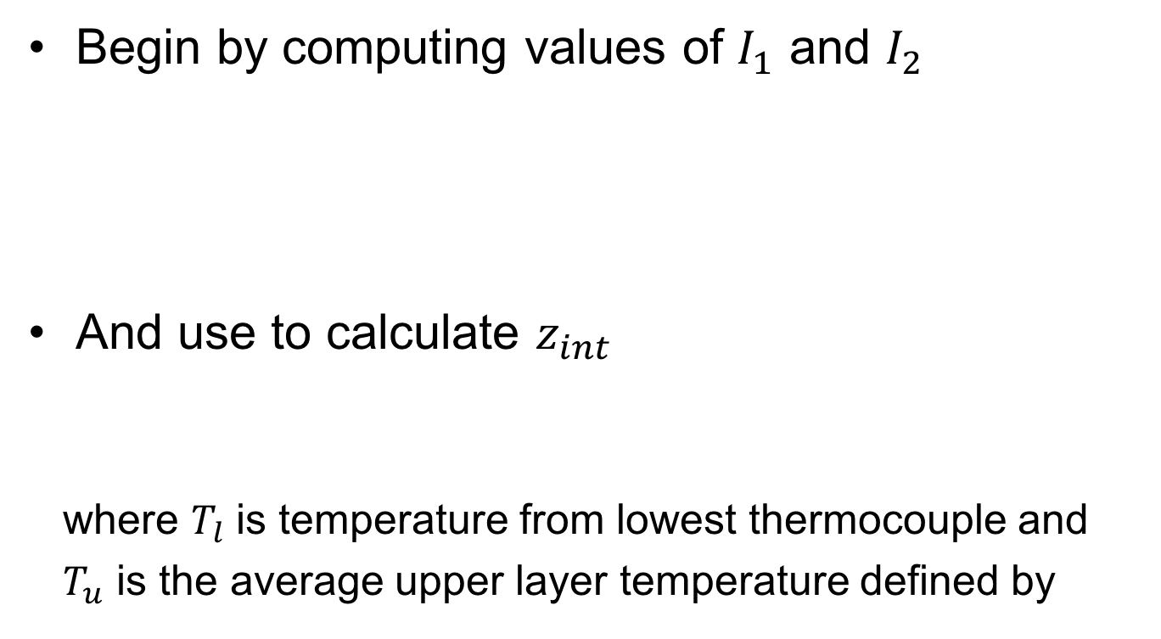
HGL Temperature Estimation
Begin by computing values of $I_{1}$ and $I_{2}$
And use to calculate $z_{int}$
where $T_{l}$ is temperature from lowest thermocouple and
$T_{u}$ is the average upper layer temperature defined by

Slide 60
HGL Data Plot – Test 22

Slide 61
HGL Summary Plot

Slide 62
Ceiling Jet Data Plot – Test 4

Slide 63
Ceiling Jet Summary Plot

Slide 64
TC Array Data Plot – Test 4

Slide 65
TC Array Summary Plot

Slide 66
O₂ Concentration Data Plot – Test 24

Slide 67
O₂ Concentration Summary Plot

Slide 68
CO₂ Concentration Data Plot – Test 6

Slide 69
CO₂ Concentration Summary Plot

Slide 70
Gas Velocity Data Plot – Test 6

Slide 71
Gas Velocity Summary Plot

Slide 72
Heat Flux Data Plot – Test 3

Slide 73
Heat Flux Summary Plot

Slide 74
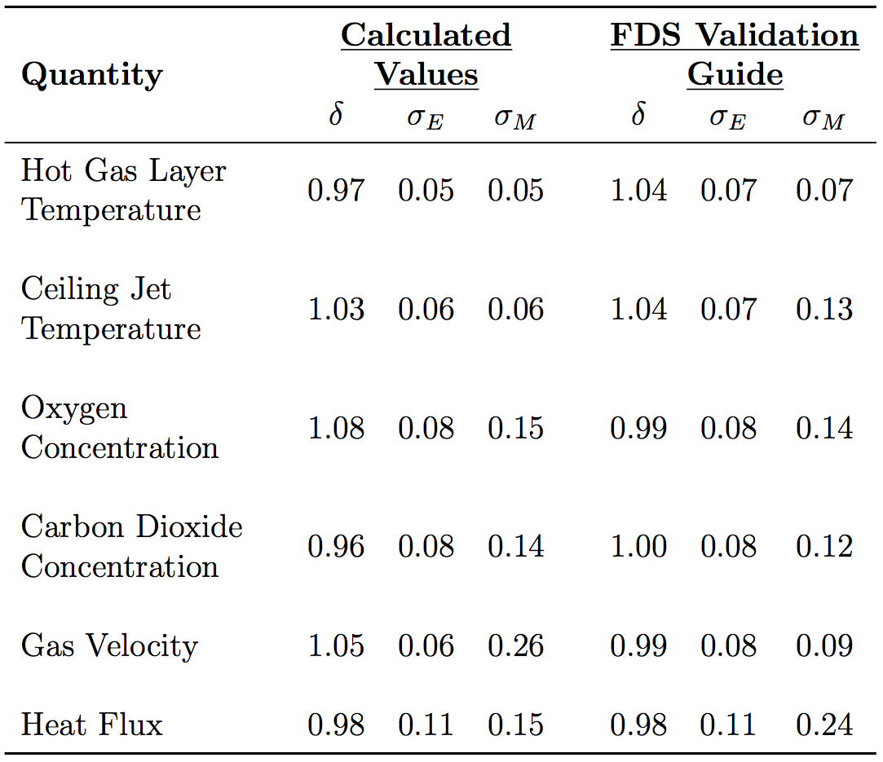
Summary of Results

Slide 75
Summary of Results
Agreement between experimental data and FDS model data
HGL, ceiling jet, and heat flux better than expected
Gas species model bias worse than value from FDS Validation Guide; relative model standard deviation 0.01 or 0.02 worse
Gas velocity contains largest discrepancy

Slide 76
Summary of Results
Discrepancy in gas velocity values could be a result of
Conducted outdoors
BDPs had the highest exp uncertainty
LES CFD models limited when it comes to turbulent gas flow at fine resolutions

Slide 77
Conclusion
Agreement between experimental data and FDS model data
HGL, ceiling jet, and heat flux better than expected
Gas species model bias worse than value from FDS Validation Guide; relative model standard deviation 0.01 or 0.02 worse
Gas velocity big discrepancy

Slide 78
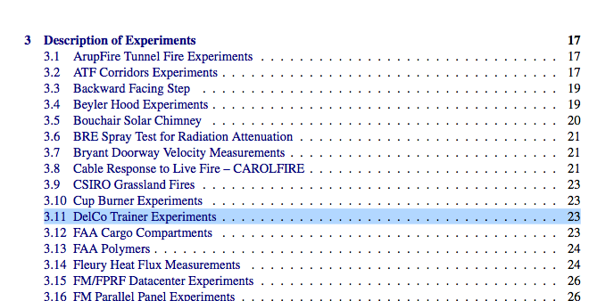
Conclusion
Set of experiments added in most recent version of FDS Validation Guide

Slide 79
Acknowledgements
NIST and specifically the following individuals
Dan Madrzykowski
Kristopher Overholt
Roy McLane
Keith Stakes
Craig Weinschenk
Delaware County Emergency Services Training Center, namely Deputy Director Kerby Kerber
Kevin McGrattan of NIST
Dr. James Milke
Dr. Arnaud Trouvé & Dr. Craig Weinschenk
Notes:
And of course the audience!

Slide 80
Questions?

Slide 81
Timing Information

Slide 82
References
[3] K. McGrattan, S. Hostikka, R. McDermott, J. Floyd, C. Weinschenk, and K. Overholt. Fire Dynamics Simulator, Technical Reference Guide, Volume 2: Verification. National Institute of Standards and Technology, Gaithersburg, Maryland, USA, and VTT Technical Research Centre of Finland, Espoo, Fin- land, sixth edition, September 2013.
[4] K. McGrattan, S. Hostikka, R. McDermott, J. Floyd, C. Weinschenk, and K. Overholt. Fire Dynamics Simulator, Technical Reference Guide, Volume 3: Validation. National Institute of Standards and Technology, Gaithersburg, Maryland, USA, and VTT Technical Research Centre of Finland, Espoo, Fin- land, sixth edition, September 2013.
[3] K. McGrattan, S. Hostikka, R. McDermott, J. Floyd, C. Weinschenk, and K. Overholt. Fire Dynamics Simulator, User’s Guide. National Institute of Standards and Technology, Gaithersburg, Maryland, USA, and VTT Technical Research Centre of Finland, Espoo, Finland, sixth edition, September 2013.
[1] Romet Limited, East Mississauga, Ontario. Rotary Gas Meter RM3000
Technical Specification, 2014.
[2] L.G. Blevins. Behavior of bare and aspirated thermocouples in
compartment fires. In National Heat Transfer Conference, 33rd
Proceedings, pages 15–17, 1999.
[3] W.M. Pitts, E. Braun, R. Peacock, H. Mitler, E. Johnson, P. Reneke, and
L.G. Blevins. Temperature uncertainties for bare-bead and aspirated
thermocouple measurements in fire environments. ASTM Special
Technical Publication, 1427:3–15, 2003.
[4] A. Lock, M. Bundy, E.L. Johnsson, A. Hamins, G.H. Ko, C. Hwang, P.
Fuss, and R. Harris. Experimental study of the effects of fuel type, fuel
distribution, and vent size on full-scale underventilated compartment fires
in an ISO 9705 room. NISTTN 1603, National Institute of Standards and
Technology, Gaithersburg, MD, 2008.
[5] R.A. Bryant. A comparison of gas velocity measurements in a full-scale
enclosure fire. Fire Safety Journal, 44:793–800, 2009.
[6] W.M. Pitts, A.V. Murthy, J.L. de Ris, J. Filtz, K. Nygard, D. Smith, and I.
Wetterlund. Round robin study of total heat flux gauge calibration at fire
laboratories. Fire Safety Journal, 41(6):459–475, 2006.

Slide 83
References
[4] A. Lock, M. Bundy, E.L. Johnsson, A. Hamins, G.H. Ko, C. Hwang, P.
Fuss, and R. Harris. Experimental study of the effects of fuel type, fuel
distribution, and vent size on full-scale underventilated compartment fires
in an ISO 9705 room. NISTTN 1603, National Institute of Standards and
Technology, Gaithersburg, MD, 2008.
[5] R.A. Bryant. A comparison of gas velocity measurements in a full-scale
enclosure fire. Fire Safety Journal, 44:793–800, 2009.
[6] W.M. Pitts, A.V. Murthy, J.L. de Ris, J. Filtz, K. Nygard, D. Smith, and I.
Wetterlund. Round robin study of total heat flux gauge calibration at fire
laboratories. Fire Safety Journal, 41(6):459–475, 2006.
[7] B. McCaffery, J. Quintiere, and M. Harkleroad. Estimating Room Fire
Temperatures and the Likelihood of Flashover Using Fire Test Data
Correlations. Fire Technology, 17(2):98–119, 1981.
[8] K. Hill, J. Dreisbach, F. Joglar, B. Najafi, K. McGrattan, R. Peacock, and A. Hamins. Verification and Validation of Selected Fire Models for Nuclear Power Plant Applications. NUREG-1824, United States Nuclear Regulatory Commission, Washington, DC, 2007.
[20] D. Gross. Data Sources for Parameters Used in Predictive Modeling of Fire Growth and Smoke Spread. NBSIR 85-3223, National Bureau of Standards (now NIST), Gaithersburg, Maryland, September 1988.
[21] USG Corporation, Chicago, IL. USG DUROCK Brand Cement Board Submittal Sheet CB399, 2016.
[22] K. McGrattan and B. Toman. Quantifying the predictive uncertainty of complex numerical models. Metrologia, 48:173–180, 2011.
[23] M.L. Janssens and H.C. Tran. Data Reduction of Room Tests for Zone Model Validation. Journal of Fire Science, 10:528–555, 1992.

